Slide 1

Final Project Data 608
Vishal Arora and Samriti Malhotra

Slide 2
Problem Statement: Depict impact of coronavirus on restaurant business .
Across the country the number of COVID-19 cases are increasing — and the number of restaurant patrons are plummeting.

Slide 3
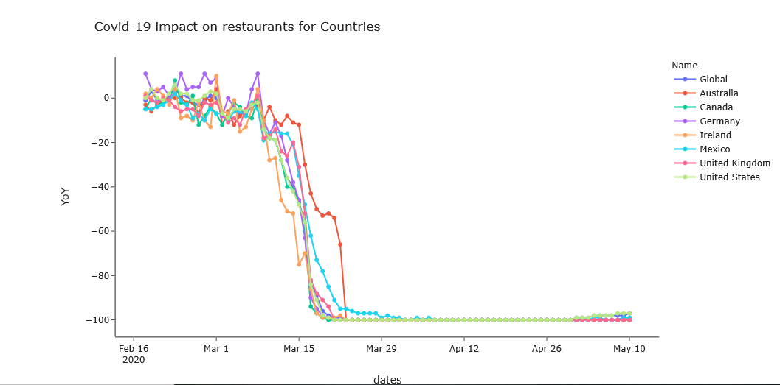
year-by-year Opentable reservation comparison for countries: The graph shows a rapid drop in restaurant customers since the second week of March in all 7 major countries and globally.
https://www.opentable.com/state-of-industry

Slide 4

Interactive app using shiny to see decline in reservation for different states in US

Slide 5
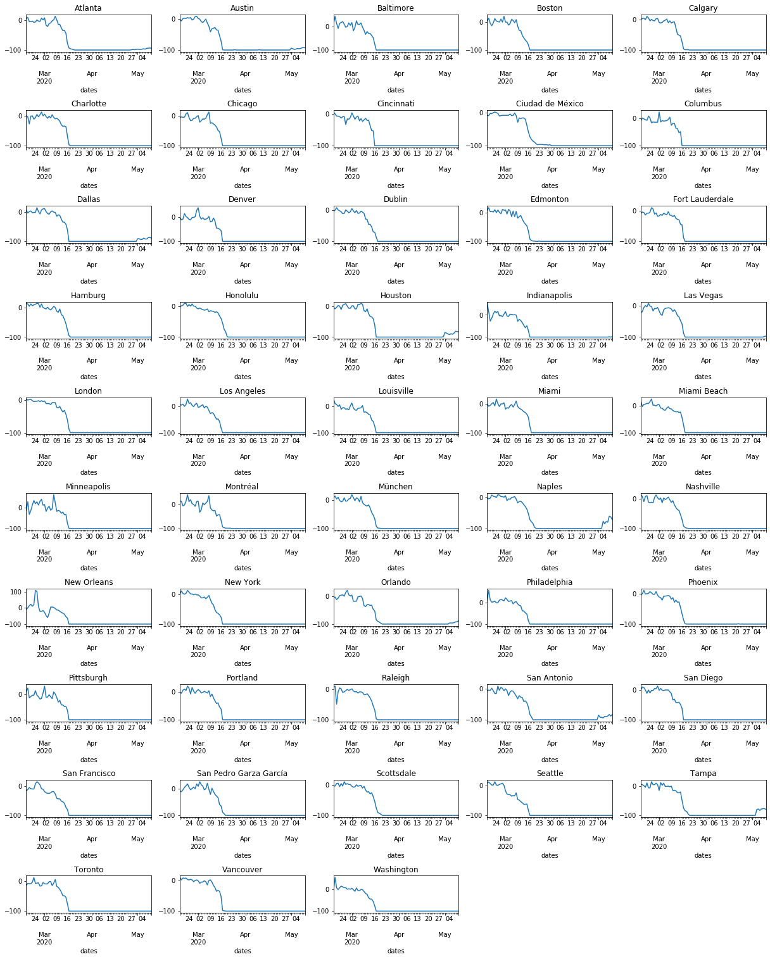
Graph show diminishing clientele and profits in important city.
Year over Year data from Open tables compares the number of seated diners on one day of week to the same day of the week 2019. Seated diners come from all channels: online reservation , phone reservations or walk-ins.

Slide 6
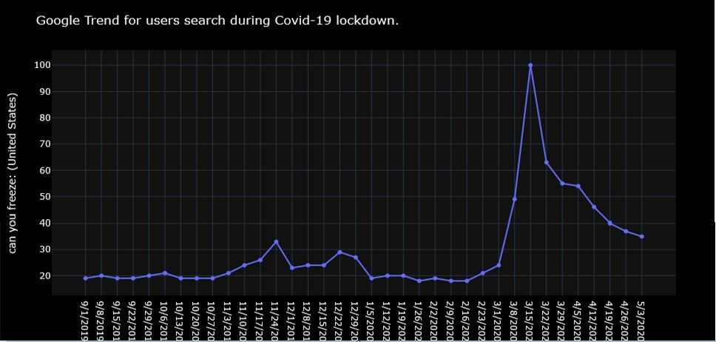
Google trend for people search result during start of pandemic.

Slide 7
Summary:
As is clear from above graphs which shows how covid-19 has severely impacted restaurant industry, we can further enhance this further by adding more categories for data visualization e.g.
Closed dine-in, open for delivery/carryout
Closed completely
Sales decline for various operators like Fast Food/ Fast Casual/ Mid scale/Fine Dine-in/Casual Dinning
How much staff cut off was done various operators.

